Slide 1


RAJALAKSHMI ENGINEERING COLLEGE
Department of Information Technology
PLANT DISEASE DETECTION USING IMAGE PROCESSING
SUPERVISOR
Mr. A IRUMPORAI M.Tech,
Assistant Professor,
Department of IT,REC
TEAM MEMBERS
RAMKUMAR K(181001072)
VIJAY BHARATHWAJ G (181001113)
AJAY DHIWAKAR S(181001501)

Slide 2
OBJECTIVE
The goal of this project is to implement a Plant Disease detection system using image processing and image recognition with the help of Convolutional Neural Network(CNN).
Plant disease can directly lead to stunted growth causing bad effects on yields and economic losses In addition, traditional methods mainly rely on specialists, experience, and manuals, but the majority of them are expensive, time-consuming, and labor-intensive with difficulty detecting precisely

Slide 3
ABSTRACT
This project proposes a disease detection and classification algorithm with the assistance of machine learning mechanisms and image recognition tools and also integrates this algorithm with an android application.
At first image preprocessing is performed and then the infected area is identified and feature extraction is performed on the same.

Slide 4
ABSTRACT
And then the image is processed by the convolutional neural network to identify whether the image of the leaf under supervision is diseased or not.
Plant disease identification can help farmers not just to increase yields and moreover help in increasing the GDP.

Slide 5
INTRODUCTION
Image processing is a method to perform operations on an image in order to improve it for further analysis.
The most common way image processing is performed into a computer vision system is the following:
Image acquisition: The camera and sensors take an image and digitize it in order to process it.
Pre-processing: Performing basic processing tasks in order to have a suitable image to work with.

Slide 6
INTRODUCTION
Processing: Here the techniques required for the correct modification of the image are applied.
Representation and description: extracting the most particular features of the objects from the already processed image, in order to differentiate these objects.
Recognition and interpretation: assigning labels to those objects to completely define them.

Slide 7
EXISTING SYSTEM
In Existing System ,To recognize apple leaf disease, Zang[1]proposed a correlation-based feature selection and SVM approach in 2021.
A. Chakraborty [4] has suggested a proposal in 2018 for visual plant stem and leaf disease detection.Using the K-Means technique, and then the segments are passed through a trained neural network.
J .Francis [9] describes the automatic identification of the plant disease by image processing from the visual symptoms by analyzing the colored images.

Slide 8
LIMITATIONS OF EXISTING SYSTEM
Support vector machines (SVM)[1] use color, texture, and shape features as input to identify apple leaf diseases like mosaic, powdery mildew, and rust. Under natural lighting, though, it is unable to detect apple leaf disease. Apple diseases such as Alternaria leaf spot, Brown spot, Mosaic, Grey spot, and Rust are five common forms that severely reduce apple yield.
However, existing research lacks a reliable and fast detection of plant disease and accuracy is below 90%.

Slide 9
PROPOSED SYSTEM
Here a novel plant leaf identification model based on a deep learning algorithm is designed to solve the above issues.
The function contains leaf retrieval, image segmentation, and identification with the utilization of integrated deep learning algorithms throughout the whole process.
The First task is leaf retrieval, but many factors pose the challenge of identification accuracy such as soil and illumination in the complex environment.

Slide 10
PROPOSED SYSTEM
The second step is Image segmentation, it is considered to be the most crucial because diagnostic precision plays an important role in detection results.
The last step is to identify the disease of leaves based on the deep learning algorithm.

Slide 11
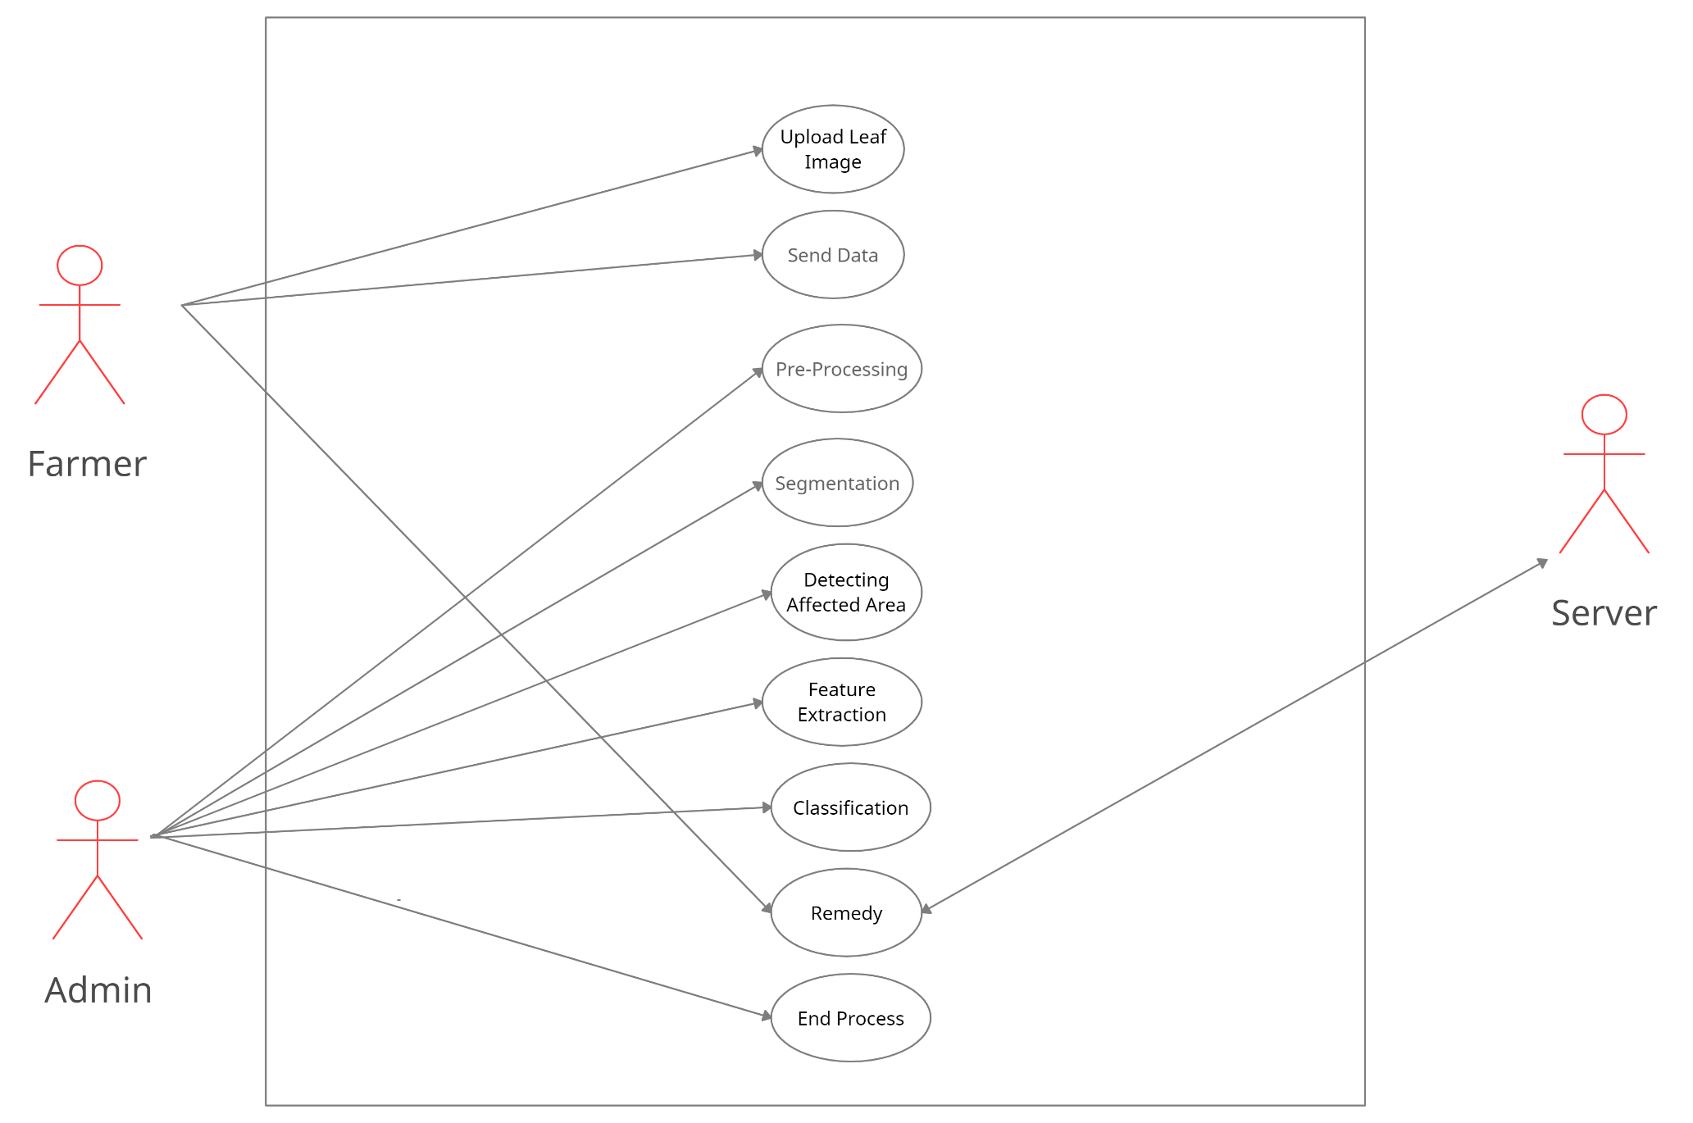
USE CASE DIAGRAM
Diagram representing the actors in the system and their interactions with the system

Slide 12
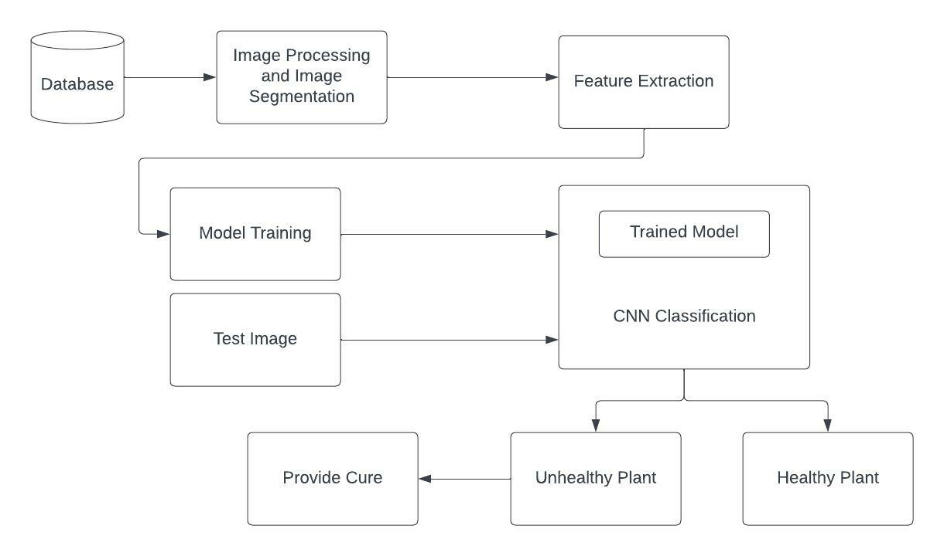
BLOCK DIAGRAM
Diagram representing the overall system workflow

Slide 13
ADVANTAGES OF
PROPOSED SYSTEM
If the image processing and CNN is applied for the disease detection then a low amount of effort will be needed, it will be less time consuming and will be more accurate.
Advantage of using image processing method and CNN is that the leaf diseases can be identified at its early stage. For improving recognition rate, most of researchers used artificial neural networks and classifiers like ANN, SVM, etc.
Early identification of plant diseases would assist farmers in growing crop yields, which would raise India's gross domestic product (GDP).

Slide 14
LIST OF HARDWARE AND SOFTWARE USED
HARDWARE USED:
Hardware: Dual core
RAM: 4GB
Hard disk: 500 GB
Processor: 64-bit,1.80GHz minimum
Input:Any input image which is diseased or healthy.

Slide 15
LIST OF HARDWARE AND SOFTWARE USED
SOFTWARE USED:
FRONT END TOOLS
Flutter (Android App Development)
BACK-END TOOLS
TensorFlow(framework)
MIDDLEWARE TECHNOLOGIES
TensorFlow Lite API
IDE
Android Studio
SIMULATION TOOLS
Android Emulator

Slide 16
MODULES DESCRIPTION
Image Acquisition :
This model allows the users to upload the image of the diseased crop/leaf from gallery or through camera.
Disease Detection :
This module is used to detect the diseased part of the leaf through image segmentation.
Disease Evaluation :
This module compares the diseased part of the input image with the trained data set and identifies the type of disease.
Remedy Suggestion :
This module provides the remedies to the users which can be used to protect the plant from getting affected by the same disease.

Slide 17

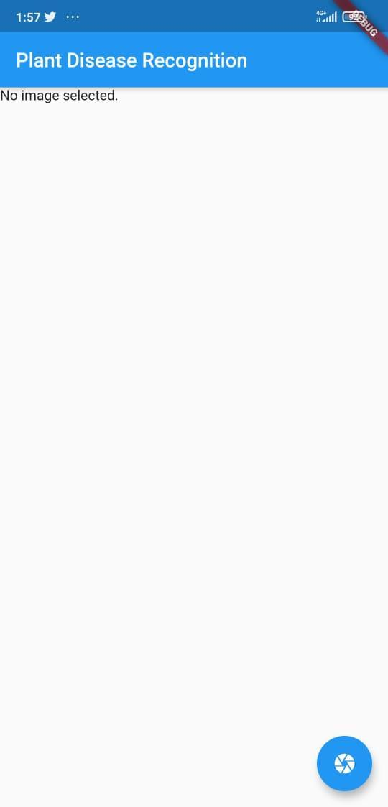
SNAPSHOTS
Splash Screen
Home Screen

Slide 18
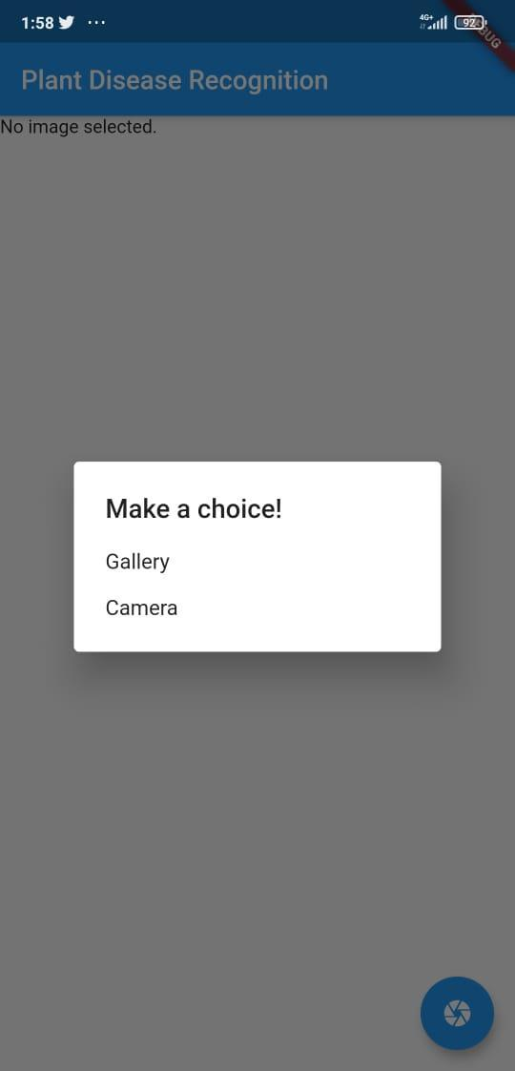
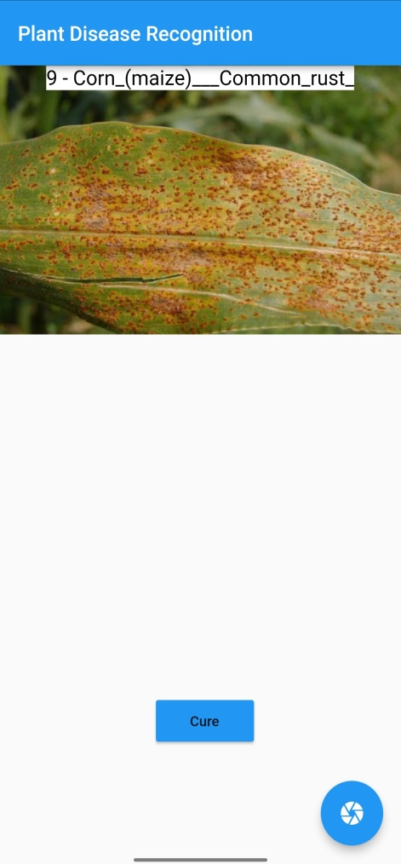
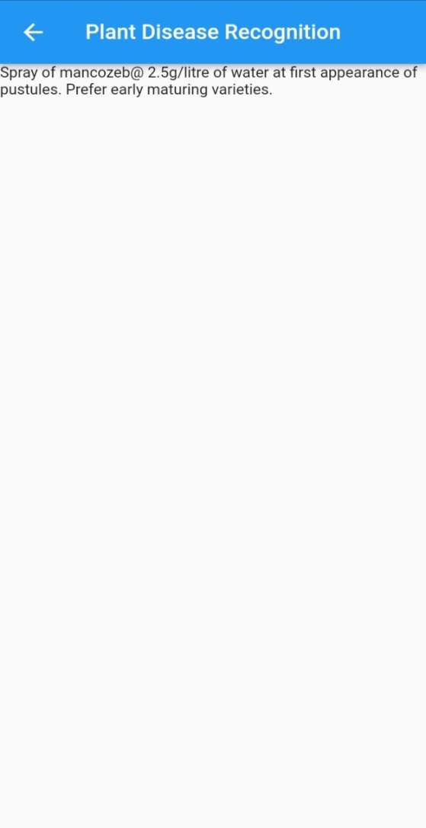
SNAPSHOTS
Option to Select Image
Disease detection
Remedy screen

Slide 19
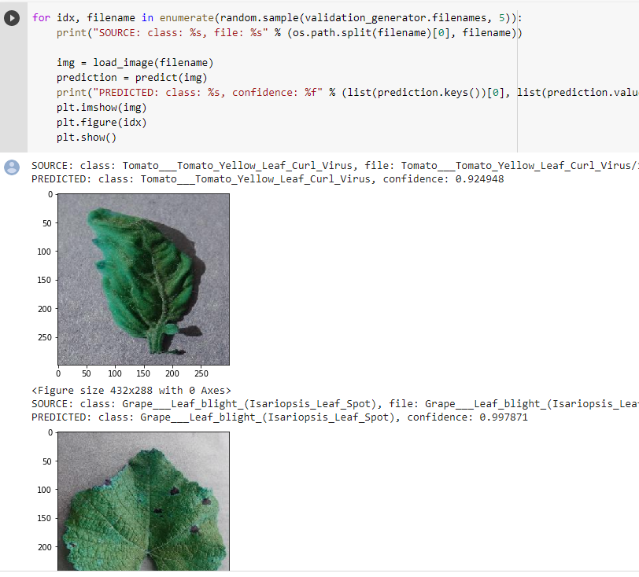
TESTING AND ANALYSIS

Slide 20
FUTURE ENHANCEMENTS
A deeper research on the topic of this project can be done by expanding the dataset and increasing the number of crop species and diseases which can be detected with the help of this application and also by integrating a module where the farmers can get live suggestions and insights from experts in the domain.
There can also be a shopping or an e-commerce based module where the farmers can buy the required chemicals for the remedy which is stated in the application.

Slide 21
FUTURE ENHANCEMENTS
The dilemma of costly domain experts will be solved if plant diseases could be detected automatically. Early identification of plant diseases would assist farmers in growing crop yields, which would raise India's gross domestic product (GDP).

Slide 22
CONCLUSION
The successful detection of plant disease is very important for cultivation of the crop and this can be done by using image processing. A smart phone application based on image processing technique which analyzes color features of spots in plants is developed and the preliminary measurement results in the recognition of the number of spots and their area on plant leaves showed accuracy higher than 90%.
Convolutional neural networks (CNN) is the most widely used classification technique for classifying plant diseases.

Slide 23
REFERENCES
[1] Wang P, Niu T, Mao Y, Zhang Z, Liu B and He D (2021) Identification of Apple Leaf Diseases by Improved Deep Convolutional Neural Networks With an Attention Mechanism .DOI:10.3389/fpls.2021.723294.
[2] P. Jiang, Y. Chen, B. Liu, D. He and C. Liang, (2019) "Real-Time Detection of Apple Leaf Diseases Using Deep Learning Approach Based on Improved Convolutional Neural Networks," in IEEE Access, vol. 7, pp. 59069-59080, 2019, doi: 10.1109/ACCESS.2019.2914929
[3] Nivedhitha P, Sankar S, Dhanalakshmi R, (2019) “An Efficient Hemorrhage Detection System using Decision Tree Classifier'', 2019, International Journal of Recent Technology and Engineering (IJRTE) ISSN: 2277-3878, Volume-8 Issue-3
[4] A. Chakraborty, (2018) "Image Processing and Image Pattern Recognition a Programming Tutorial," 2018 First International Conference on Artificial Intelligence for Industries (AI4I), Laguna Hills, CA, USA, 2018, pp. 122-123, doi: 10.1109/AI4I.2018.8665702.

Slide 24
REFERENCES
[5] B. Nivedha, M. Priyadharshini, E. Thendral and T. Deenadayalan, "Lossless Image Compression in Cloud Computing," (2017) International Conference on Technical Advancements in Computers and Communications (ICTACC), Melmaruvathur, India, 2017, pp. 112-115, doi: 10.1109/ICTACC.2017.37.
[6] Bharate A. A. and M. S. Shirdhonkar, (2017) "A review on plant disease detection using image processing," 2017 International Conference on Intelligent Sustainable Systems (ICISS), Palladam, India, 2017, pp. 103-109, doi: 10.1109/ISS1.2017.8389326.
[7] Chuanlei, Z. & Shanwen, Z. & Jucheng, Y. & Yancui, S. & Jia, C.. (2017). Apple leaf disease identification using genetic algorithm and correlation based feature selection method. 10. 74-83. 10.3965/j.ijabe.20171002.2166.
[8] Jose, D., Chithara, A.N., Nirmal Kumar, P. et al. (2017) Automatic Detection of Lung Cancer Nodules in Computerized Tomography Images. Natl. Acad. Sci. Lett. 40, 161–166 (2017).

Slide 25
REFERENCES
[9] J. Francis, Anto Sahaya Dhas D and Anoop B K, (2016) "Identification of leaf diseases in pepper plants using soft computing techniques", 2016 Conference on Emerging Devices and Smart Systems (ICEDSS), Namakkal, India, 2016, pp. 168-173, doi: 10.1109/ICEDSS.2016.7587787
[10] S. D. Khirade and A. B. Patil, (2015) "Plant Disease Detection Using Image Processing," 2015 International Conference on Computing Communication Control and Automation, Pune, India, 2015, pp. 768-771, doi: 10.1109/ICCUBEA.2015.153
[11] Manisha Bhange, H.A. Hingoliwala, (2015) “Smart Farming: Pomegranate Disease Detection Using Image Processing”, Procedia Computer Science, Volume 58, 2015, Pages 280-288, ISSN 1877-0509.
[12] Barbedo, Jayme & Godoy, Claudia. (2015). Automatic Classification of Soybean Diseases Based on Digital Images of Leaf Symptoms.

Slide 26
REFERENCES
[13] Awate A. , D. Deshmankar, G. Amrutkar, U. Bagul and S. Sonavane, (2015). "Fruit disease detection using color, texture analysis and ANN," 2015 International Conference on Green Computing and Internet of Things (ICGCIoT), Greater Noida, India, 2015, pp. 970-975, doi: 10.1109/ICGCIoT.2015.7380603.
[14] Rong Zhou, Shun’ichi Kaneko, Fumio Tanaka, Miyuki Kayamori, Motoshige Shimizu, (2014) “Disease detection of Cercospora Leaf Spot in sugar beet by robust template matching”, Computers and Electronics in Agriculture, Volume 108, 2014 Pages 58-70, ISSN 0168-1699,
[15] S. R. Rupanagudi, B. S. Ranjani, P. Nagaraj and V. G. Bhat, (2014) "A cost effective tomato maturity grading system using image processing for farmers," 2014 International Conference on Contemporary Computing and Informatics (IC3I), Mysore, India, 2014, pp. 7-12, doi: 10.1109/IC3I.2014.7019591.

Slide 27
THANK YOU

